Slide 1

HISTORY OF THE EMERGENCE OF INDEPENDENT BANGLADESH
Dr. Md. Abdul Alim
B. A (Hon’s), M. A (History), M. Phil (Raj), Ph. D (Raj)
Email:doctorabdulalim64@gmail.com
Cell: +880 01718-787466

Slide 2
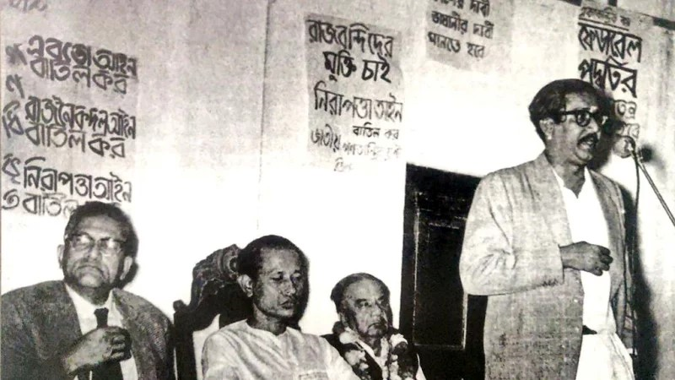
UNITED FRONT – 1954 ELECTION
The Bengali nation first united in an unprecedented way centering the 1952 Language Movement, which ultimately paved the way for realizing the rights and protests the exploitation of the Pakistani government. As young Sheikh Mujibur Rahman assumed the general secretary of the then Awami Muslim League, he rose the nation with the spirit of the language movement. He drew the world’s attention by delivering a speech in Bangla at the World Peace Council in China in 1953. Another renowned author Munoz Basu from West Bengal also gave his speech in Bangla in the programmed.

Slide 3
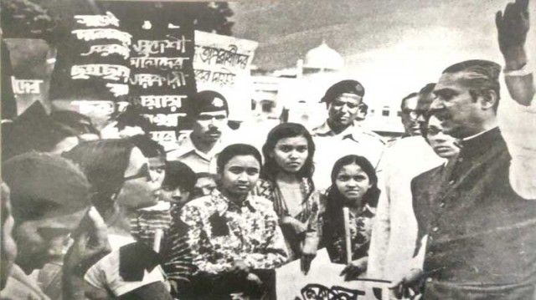
UNITED FRONT – 1954 ELECTION
Regarding Bangabandhu’s effort to ensure the highest status of the Bangla language, language movement veteran Gaziul Haque wrote that the first procession to mark the first anniversary of the language movement in 1953 was started with the arrival of Ataur Rahman Khan and Sheikh Mujibur Rahman among others in the university premises.

Slide 4
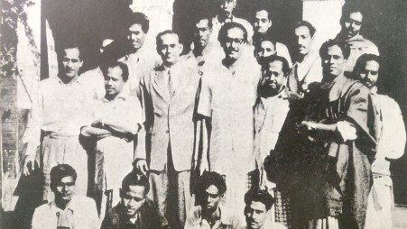
UNITED FRONT – 1954 ELECTION
The procession parading different important streets of the capital ended in the Armanitola followed by a rally where Sheikh Mujibur Rahman spoke on behalf of the Awami League. The rally demanded immediate release of all language movement protesters and prayed for the departed soul of the language martyrs.

Slide 5
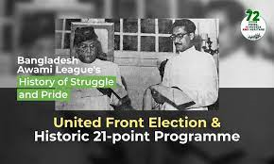
UNITED FRONT – 1954 ELECTION
East Bengal witnessed a fresh agitation for the state status of the Bangla language again from 1953. People raised their voices for the demands and rights amid the social, economic and political exploitation and discrimination of West Pakistan. Sheikh Mujibur Rahman, who had just been Awami Muslim League’s general secretary after the illness of Shamsul Haq, consequently became the torchbearer of the nation.

Slide 6
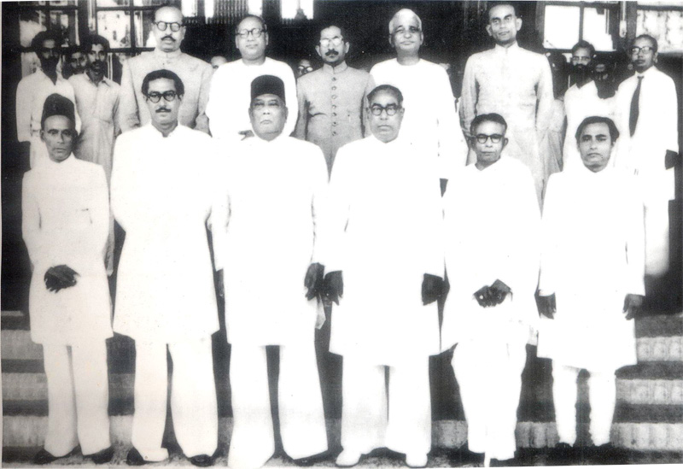
UNITED FRONT – 1954 ELECTION
As the Pakistan government announced the schedule of the election in the East Bengal Legislative Assembly, an alliance named Jukto Front (United Front) was formed with Awami Muslim League, Krishak Sramik Party, Nezam-e-Islam and Ganatantri Dal on December 4 in 1953. To counter the then party in power Muslim League, the Front came up with the historic Twenty-One Point Programme as the election manifesto giving priorities to the status of the Bangla language and rights of the Bengali nation.

Slide 7
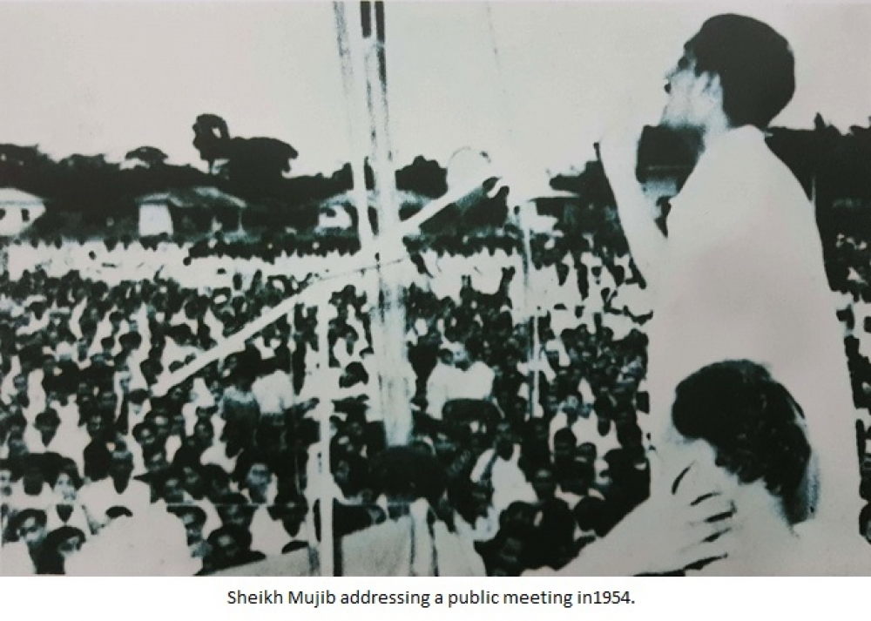
THE 21-POINTS & UNITED FRONT – 1954 ELECTION
To recognize Bangla as one of the State Languages of Pakistan;
To abolish without compensation zamindari and all rent receiving interest in land, and to distribute the surplus lands amongst the cultivators; to reduce the rent to a fair level and abolish the certificate system of realizing rent;
To nationalize the jute trade and bring it under the direct control of the government of East Bengal, set fair price of jute to the growers and to investigate into the jute-bungling during the Muslim League regime to punish those found responsible for it;
To introduce co-operative farming in agriculture and to develop cottage industries with full government subsidies;

Slide 8
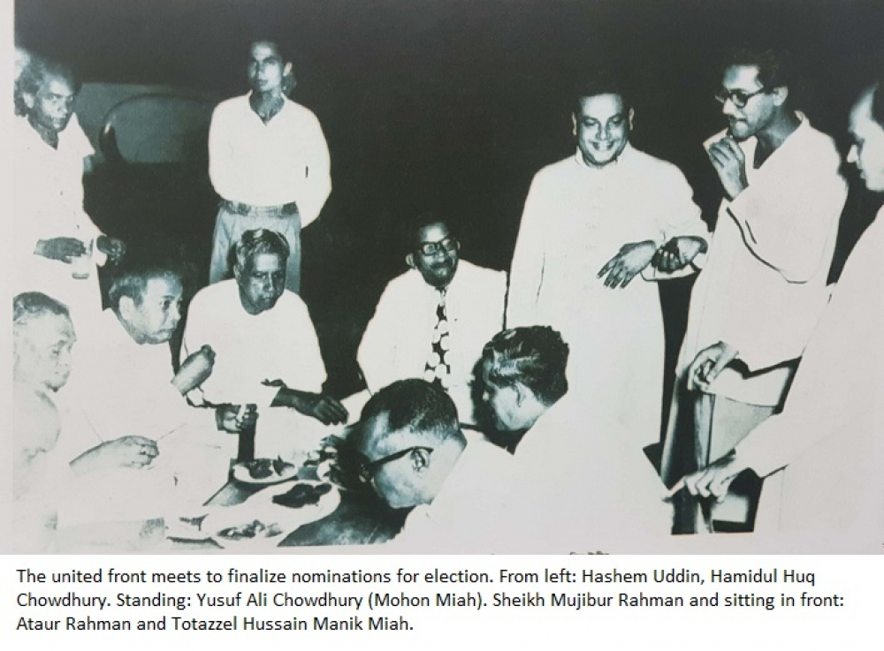
THE 21-POINTS & UNITED FRONT – 1954 ELECTION
To start salt industry (both small and large scale) in order to make East Bengal self-sufficient in the supply of salt, and to investigate into the salt-bungling during the Muslim League regime to punish the offenders;
To rehabilitate immediately all the poor refugees belonging to the artisan and technician class;
To protect the country from flood and famine by means of digging canals and improving irrigation system;
To make the country self-sufficient by modernizing the method of cultivation and industrialization, and to ensure the rights of the laborer as per ILO Convention;

Slide 9
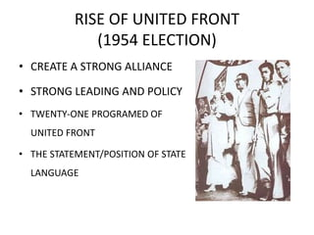
THE 21-POINTS & UNITED FRONT – 1954 ELECTION
To introduce free and compulsory primary education throughout the country and to arrange for just pay and allowances to the teachers;
To restructure the entire education system, introduce mother tongue as the medium of instruction, remove discrimination between government and private schools and turn all the schools into government-aided institutions;
To repeal all reactionary laws including those of the Dhaka and Rajshahi Universities and to make them autonomous institutions; to make education cheaper and easily available to the people;
To curtail the cost of administration and to rationalise the pay scale of high and low paid government servants. The ministers shall not receive more than 1000 taka as monthly salary;

Slide 10
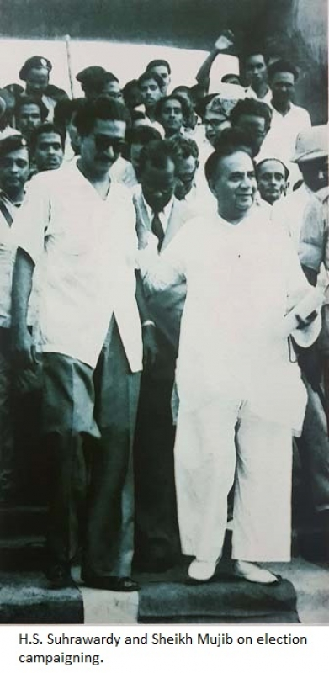
THE 21-POINTS & UNITED FRONT – 1954 ELECTION
To take steps to eradicate corruption, nepotism and bribery, and with this end in view, to take stocks of the properties of all government officers and businessmen from 1940 onward and forfeit all properties the acquisition of which is not satisfactorily accounted for;
To repeal all Safety and Preventive Detention Acts and release all prisoners detained without trial, and try in open court persons involved in anti-state activities; to safeguard the rights of the press and of holding meetings;
To separate the judiciary from the executive;

Slide 11
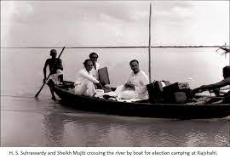
THE 21-POINTS & UNITED FRONT – 1954 ELECTION
To locate the residence of the chief minister of the United Front at a less costly house, and to convert Burdwan House into a students hostel now, and later, into an institute for research on Bangla language and literature;
To erect a monument in memory of the martyrs of the Language Movement on the spot where they were shot dead, and to pay compensation to the families of the martyrs;
To declare 21st of February as ‘Shaheed Day’ and a public holiday;
The Lahore Resolution proposed full autonomy of East Bengal leaving defense, foreign affairs and currency under the central government. In the matter of defense, arrangements shall be made to set the headquarters of the army in West Pakistan and the naval headquarters in East Bengal and to establish ordnance factories in East Bengal, and to transform Ansar force into a full-fledged militia equipped with arms;

Slide 12
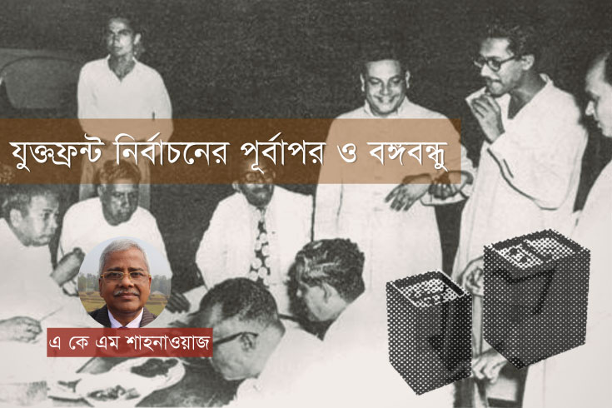
THE 21-POINTS & UNITED FRONT – 1954 ELECTION
The United Front Ministry shall on no account extend the tenure of the Legislature and shall resign six months before the general elections to facilitate free and fair elections under an Election Commission;
All casual vacancies in the Legislature shall be filled up through by-elections within three months of the vacancies, and if the nominees of the Front are defeated in three successive by-elections, the ministry shall resign from office.

Slide 13
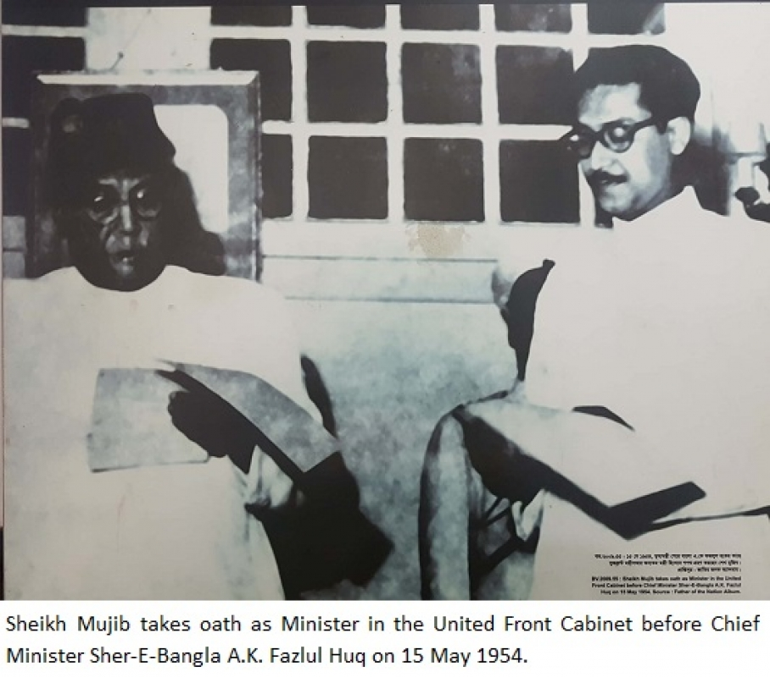
VICTORY IN THE FIRST ELECTION IN 1954 ELECTION
One of the key leaders of the United Front, Sheikh Mujib rushed to villages after villages to seek support for the 21-point programme. He held public rallies and delivered fierce speeches to raise the Bengali nation. Young Sheikh Mujibur Rahman defeated his opposition candidate Wahiduzzaman from Muslim League in his seat in Tungipara and elected as a member of the legislative body.
In the elections held in March 1954, the United Front managed to bag only nine seats whereas Awami Muslim League won 143 seats and Krishak Sramik Party 48 seats. Sheikh Mujibur Rahman sown as the youngest minister in the cabinet. He became the minister for agriculture, forest and cooperative ministry.

Slide 14
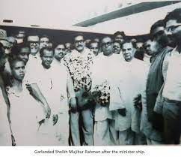
VICTORY IN THE FIRST ELECTION IN 1954 ELECTION
But the central government hatched a conspiracy and ran a riot at Adamjee Jute Mills where approximately 500 Bengali were killed. The newly elected cabinet was abolished, and the central government took over the power under section 92(A) on May 9 in 1954 holding the Jukto Front cabinet responsible for the riots. Iskander Mirza was also appointed as the governor for East Bengal on the same day. Then, there started a massive crackdown on Jukto Front and Awami Muslim League arresting thousands, including Sheikh Mujibur Rahman. As AK Fazlul Huq was in house arrest and Mawlana Bhashani and Suhrawardy were staying abroad, there was no demonstration against the incidents.

Slide 15
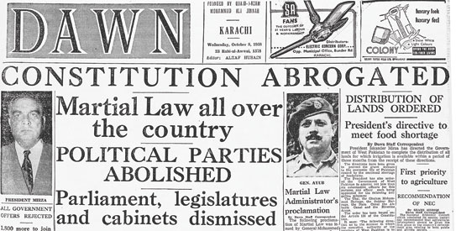
MARTIAL LAW IN 1958
President Iskander Mirza proclaimed martial law by compelling the parliamentary government of Malik Feroz Khan to step down on 7 October 1958. Major General Omrao Khan was appointed the Martial Law Administrator in East Pakistan but in a few days, General Ayub Khan assumed to the presidency through a coup against Iskander Mirza.

Slide 16
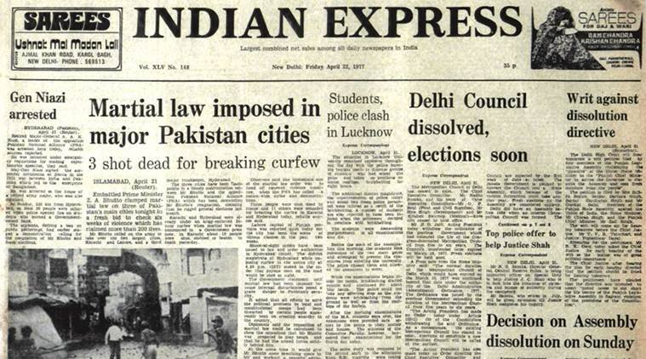
BASIC DEMOCRACY OF AYUB KHAN
Basic Democracy of Ayub Khan: After consolidating power in 1958, General Ayub Khan initiated to bring about absolute changes in the government system and politics in Pakistan. He abandoned the traditional democratic practices and introduced a strange and new electoral process. It was based on a concept called 'Basic Democracy. Basic Democracy is a sort of restricted democracy in which a few people would enjoy the privilege of electing the president.

Slide 17
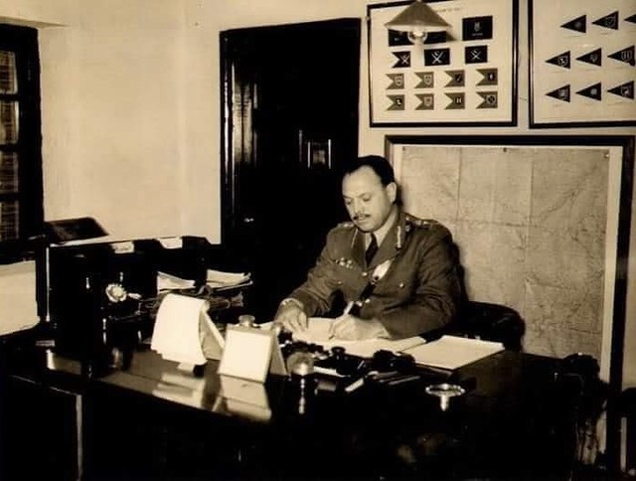
BASIC DEMOCRACY OF AYUB KHAN
Initially, Basic Democracy had four tires such as.
Union council (in the villages) and town and union committees (in urban areas)
Thana council in East Pakistan and Tahsil council in West Pakistan
District Council
Divisional council.

Slide 18
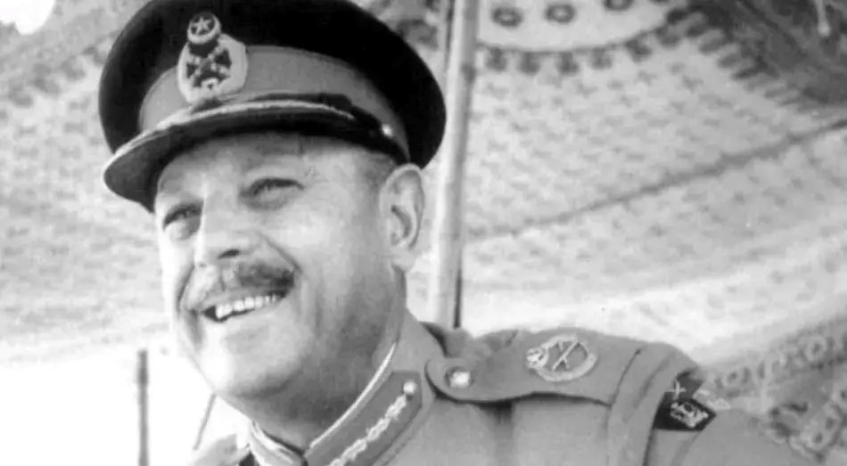
BASIC DEMOCRACY OF AYUB KHAN
The councils consisted of elected and nominated members as well. There were 40000 electoral units in each part of Pakistan total number of 80,000 in the country. The members of this Basic Democracy were the Basic Democrats or BD members. People’s participation was limited in electing BD members. BD members were the valid electors. None but these BD members could elect the President and the members of the National and Provincial Legislative Councils..

Slide 19
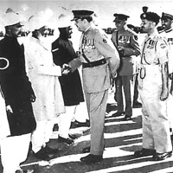
BASIC DEMOCRACY OF AYUB KHAN
Ayub Khan became the president for the following five years after winning the confidence votes of these members. Thus he also gained the authority to formulate a constitution for the country. The new constitution was made to the public on 1 March 1962 and the martial law was withdrawn on 8 June.

Slide 20
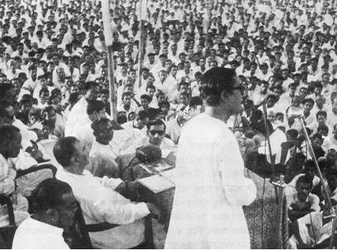
THE MOVEMENT AGAINST MILITARY RULE
Suhrawardy was taken into custody alleged anti-state conspiracy. The news of Suhrawardy's arrest sparked students' reactions in East Pakistan. They called for a strike and brought out processions. This student program originated the anti-Ayub movement in East Pakistan. The government closed the University of Dhaka.

Slide 21
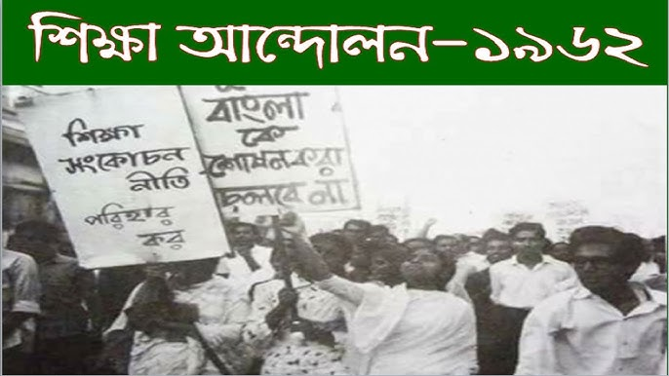
THE MOVEMENT AGAINST MILITARY RULE
Students confronted huge policing activities on them including arrests and tortures. When Ayub Khan announced the enactment of a new constitution, the student community in East Pakistan staged demonstrations and abstained from attending classes. Intellectuals, teachers, politicians, and others extended their support to the students' movement opposing the new constitution. Ayub Khan and East Pakistan Governor Monaem Khan took strict oppressive measures to control the student movement.

Slide 22
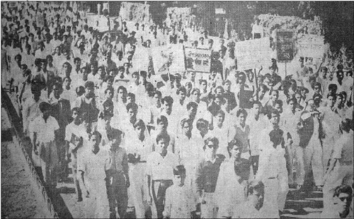
THE MOVEMENT AGAINST MILITARY RULE
The student movement got momentum when the Sharif Commission Report on education issues was published in August 1962. The recommendations in the report posed the threat of jeopardizing students' interests and rights. This resulted in a massive student movement.

Slide 23
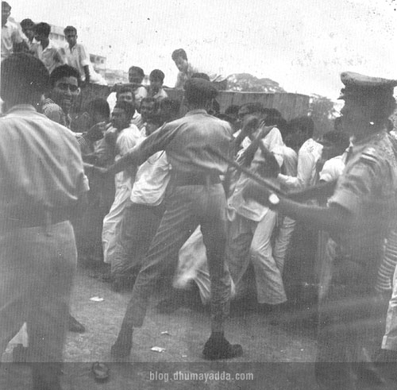
THE MOVEMENT AGAINST MILITARY RULE
This movement is known as 'bashottir shikkha andolon' (Education Movement, ‘62). This movement forced the government to suspend the policy recommendations of the Sharif Commission.

Slide 24
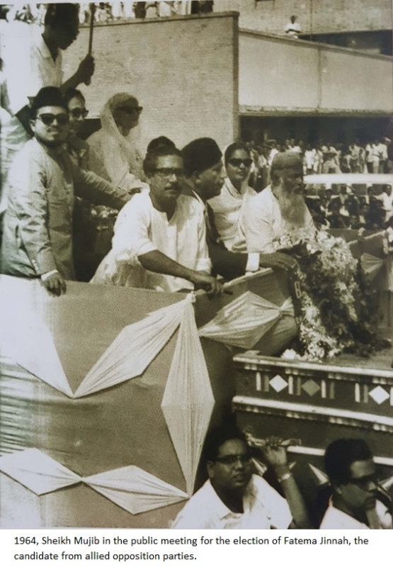
THE MOVEMENT AGAINST MILITARY RULE
When martial law was suspended on 8 June 1962, rights for politics under the banner of political parties were revived. Ayub Khan himself formed a political party named Convention Muslim League. At the same time, Suhrawardy urged all the opposition parties to be united to form a coalition. As a result, National Democratic Front or NDF was formed comprising Awami League, Nezam-e-Islami, National Awami Party, Council Muslim League and Muslim League under Nurul Amin's leadership. The aims of this front were to regain democracy and to switch back to the constitution of 1956. This front became popular very quickly.

Slide 25
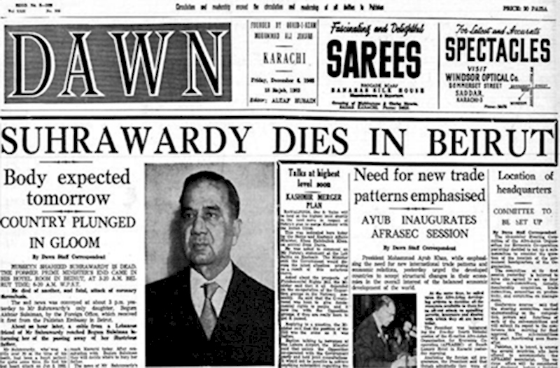
THE MOVEMENT AGAINST MILITARY RULE
Suhrawardy died in December 1963. Bangabandhu Sheikh MujiburRahman was elected the General Secretary of the party. Awami League started its new journey under his leadership However, in the presidential election on 2 January 1965, the Awami League, NAP, Council Muslim League, Nezam- e-Islami, etc. joined again to form a Combined Opposition Party (COP) so that they could nominate a single candidate against Ayub Khan. COP nominated Fatima Jinnah the younger sister of Muhammad Ali Jinnah to contest for the presidency of Pakistan. Though people expressed their enthusiasm about Fatima Jinnah, Ayub Khan won the election race and became the president. National and provincial Legislative Council election was held after the presidential election. Ayub Khan's Convention Muslim League won the majority in this election too.

Slide 26


